Slide 1
Linear Regression vs. Logistic Regression
Eng. Maria Ayman

Slide 2
Introduction to Linear Regression
Linear Regression is a supervised machine learning algorithm used to predict a continuous numerical value from one or more input features.
It learns the relationship between independent variables (features) and a dependent variable (target).
The model represents this relationship using a linear equation.
During training, the model estimates the parameters that best fit the observed training data.
Linear Regression is commonly used for prediction, forecasting, and understanding relationships between variables.
Examples of Applications
  Predicting house prices based on size and location.
  Estimating students’ exam scores based on study hours.
  Forecasting sales based on advertising expenditure.
  Predicting energy consumption based on environmental conditions.

Slide 3
Understanding the Regression Problem
Input Features and Target Variable
The input features represent the information used by the model to make a prediction.
The target variable is the numerical value that the model attempts to predict.
Each training example contains a set of input features and its corresponding actual target value.
The model learns a relationship from the training examples and applies it to unseen data.
In regression, the predicted output is a numerical value rather than a class label.
Example: Predicting Exam Scores
Feature: Number of study hours.
Target: Actual exam score.
Objective: Learn a relationship that can estimate the score of a student with a given number of study hours.
Study Hours ((X)) | Actual Exam Score (y)
1 | 50
2 | 55
3 | 65
4 | 70
5 | 80

Slide 4

The Linear Regression Model
Mathematical Representation
For a model with one input feature, the prediction is represented by:
Where:
X: The input feature.
y: The predicted target value.
b0: intercept, representing the predicted value when x = 0.
b1: slope coefficient, representing the change in the predicted value associated with a one-unit increase in x.
Interpretation:
A positive slope indicates that the predicted target increases as the feature increases.
A negative slope indicates that the predicted target decreases as the feature increases.
A zero slope indicates that the prediction does not change with the feature.
The intercept and slope are estimated during model training.

Slide 5
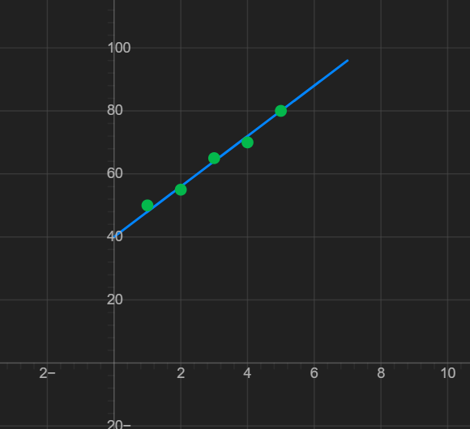
Visualizing Linear Regression
The Best-Fit Line
Linear Regression represents the relationship between an input feature and a target variable using a straight line.
Each point in a scatter plot represents an observed data sample.
The vertical distance between an observed point and the regression line represents the prediction error, called the residual.
The model estimates a line that minimizes the sum of squared residuals when using Ordinary Least Squares (OLS).
The fitted line can then be used to predict target values for new observations.

Slide 6
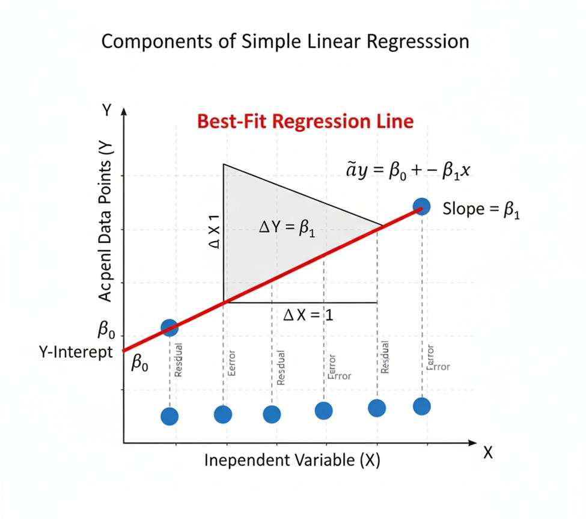
The Linear Regression Model

Slide 7
Model Parameters: Slope and Intercept
The Role of the Model Parameters
The slope b1 determines the direction and rate of change in the predicted target.
The intercept b0 determines where the line crosses the vertical axis.
Both parameters affect the position and orientation of the regression line.
The learning process estimates these parameters from the training data.
Suppose the learned model is:
Y = 40 +8x
For a student who studies for five hours:
Y = 40+8*5 = 80
The intercept is 40., The slope is 8.
The predicted exam score is 80.
Interpretation: According to this model, each additional study hour is associated with an increase of 8 points in the predicted score. This interpretation describes the fitted model and does not establish causation.

Slide 8

Prediction Errors and Residuals
Understanding Residuals
A prediction error occurs when the predicted value differs from the actual observed value.
A residual is the difference between the actual target value and the predicted value.
Residuals help measure how closely the regression model fits the observed data.
Example
If the actual exam score is 65 and the predicted score is 64:
E = 65 – 64 = 1
The model underestimates the score by one point.
If the predicted score is 70:
E = 65 – 70 = -5
The model overestimates the score by five points.
Key Point: A positive residual indicates underprediction, while a negative residual indicates overprediction.

Slide 9

The Least Squares Objective
How Does Linear Regression Find the Best-Fit Line?
A regression model can produce different lines by changing its intercept and slope.
Each line produces a different set of predictions and residuals.
Ordinary Least Squares (OLS) selects the parameters that minimize the sum of squared residuals.
Squaring the residuals prevents positive and negative errors from cancelling each other and gives larger errors a greater contribution to the total.
Where:
SSE: Sum of Squared Errors.
N: Number of observation.
Y: actual target value
Y^: predicted target value ➔ (b0+b1x).
Objective: Find the values of b0 and b1 that minimize the SSE on the training data

Slide 10
Evaluating Linear Regression
Common Regression Evaluation Metrics
Mean Absolute Error (MAE): Measures the average absolute difference between actual and predicted values.
Mean Squared Error (MSE): Measures the average squared prediction error.
Root Mean Squared Error (RMSE): The square root of MSE, expressed in the same units as the target.
Coefficient of Determination (R2): Measures how much of the target's variation is explained by the model relative to predicting the target mean.
Interpretation
Lower MAE, MSE, and RMSE generally indicate smaller prediction errors when evaluating the same target and dataset.
An R2 value closer to 1 generally indicates a better fit relative to the mean baseline.
R2 can be negative on test data when the model performs worse than predicting the training target mean.
Evaluation should be performed on data that was not used to train the model.

Slide 11
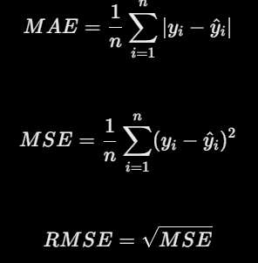
Evaluating Linear Regression

Slide 12
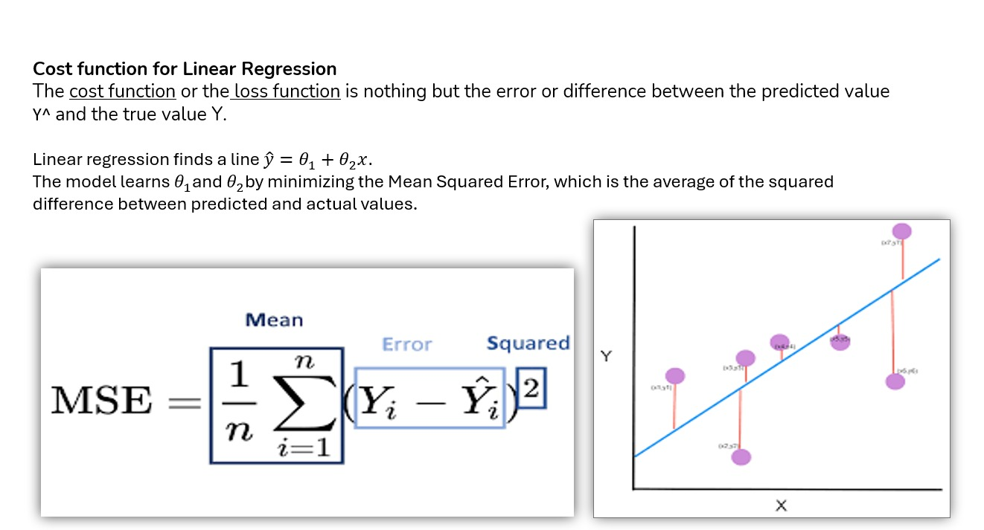
Evaluating Linear Regression

Slide 13
Advantages and Limitations of Linear Regression
Advantages
Simple to understand, implement, and interpret.
Computationally efficient for many small and medium-sized datasets.
Provides interpretable coefficients that describe fitted relationships.
Serves as a useful baseline for regression problems.
Limitations
Assumes a linear relationship between the features and the expected target.
Can be sensitive to outliers.
May be affected by strong multicollinearity among input features.
Can underfit complex nonlinear relationships.
Extrapolation beyond the observed data range may produce unreliable predictions.
Typical Applications: Price prediction, sales forecasting, demand estimation, and numerical trend analysis.

Slide 14
From Regression to Classification
Regression vs. Classification
Regression predicts a numerical quantity.
Classification predicts a discrete category or class label.
Binary classification involves exactly two possible classes.
The classes are often represented numerically as 0 and 1.
Main Objective: Learn a decision rule that assigns each input observation to one of the two classes.
Problem | Class 0 | Class 1
Student performance | Fail | Pass
Email filtering | Not Spam | Spam
Medical screening | Negative | Positive
Customer analysis | Will Stay | Will Leave

Slide 15


What Is a Binary Linear Classifier
A binary linear classifier is a classification model that separates two classes using a linear decision function.
The model calculates a score from the input features, their weights, and a bias term.
A decision rule converts the score into one of the two class labels.
For two input features, the decision boundary is a straight line in a two-dimensional feature space.
In higher-dimensional spaces, the corresponding boundary is a hyperplane.
Linear Decision Function
Decision Boundary
The boundary divides the feature space into regions associated with different predicted classes.

Slide 16
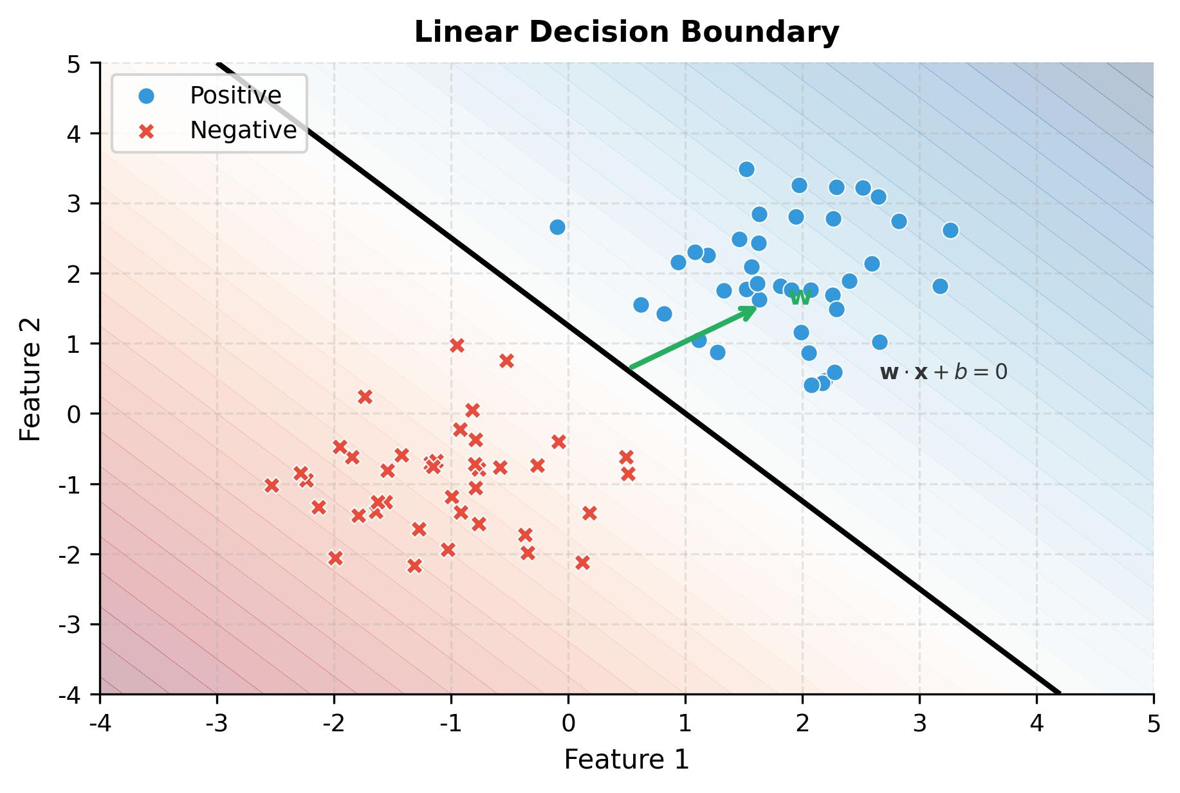
Understanding the Decision Boundary
How Does the Classifier Make a Decision?
The decision boundary separates regions assigned to different classes.
An observation's position relative to the boundary determines its predicted class.
The weights determine the orientation of the boundary, while the bias influences its position.
A linear boundary may not separate classes that have a complex nonlinear structure

Slide 17
The Relationship Between Linear Classification and Logistic Regression
Important Conceptual Distinction
Binary classification is the task of assigning observations to one of two classes.
A binary linear classifier uses a linear decision function to separate the classes.
Logistic Regression is a specific supervised learning algorithm commonly used for binary classification.
Logistic Regression calculates a linear score and transforms it into a probability using the sigmoid function.
The predicted probability is then compared with a decision threshold to obtain a class label.
Examples of Linear Classification Algorithms
Logistic Regression.
Perceptron.
Linear Support Vector Machine (Linear SVM).
Key Point: These algorithms can use linear decision boundaries, but they differ in their learning objectives, training procedures, and decision rules.

Slide 18
The Logistic Regression Model
Logistic Regression is a supervised machine learning algorithm primarily used for classification.
Despite its name, it is commonly used to predict class probabilities rather than continuous numerical targets.
It is particularly suitable for binary classification problems.
The model calculates a linear combination of the input features and transforms the result into a probability.
The predicted probability is used to determine the most likely class according to a selected decision threshold.
Example: Student Pass/Fail Prediction
Inputs: Study hours and attendance percentage.
Target classes: Fail (0) and Pass (1).
Model output: Estimated probability that a student will pass.
Final prediction: Pass or Fail, based on the decision threshold.

Slide 19
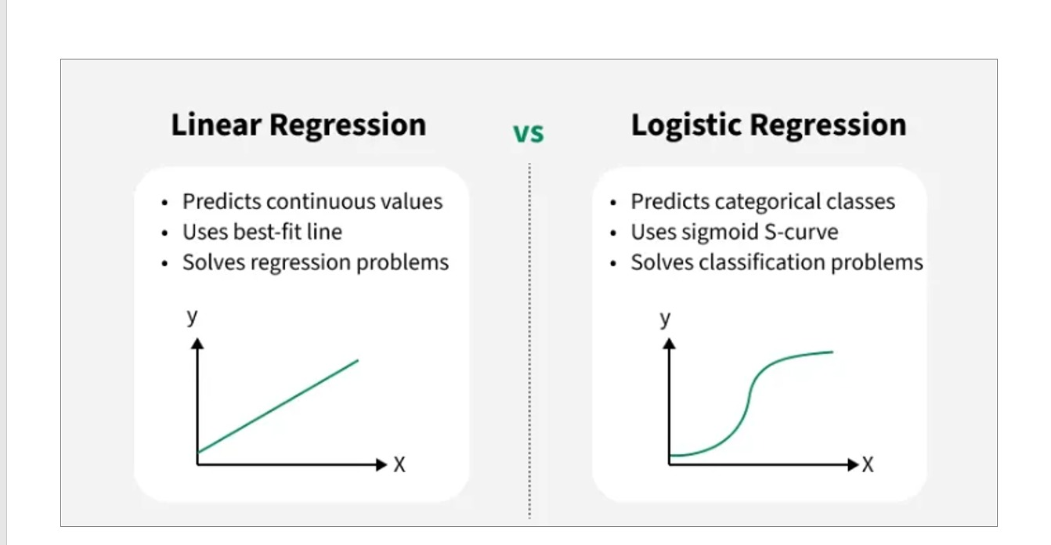
The Logistic Regression Model

Slide 20
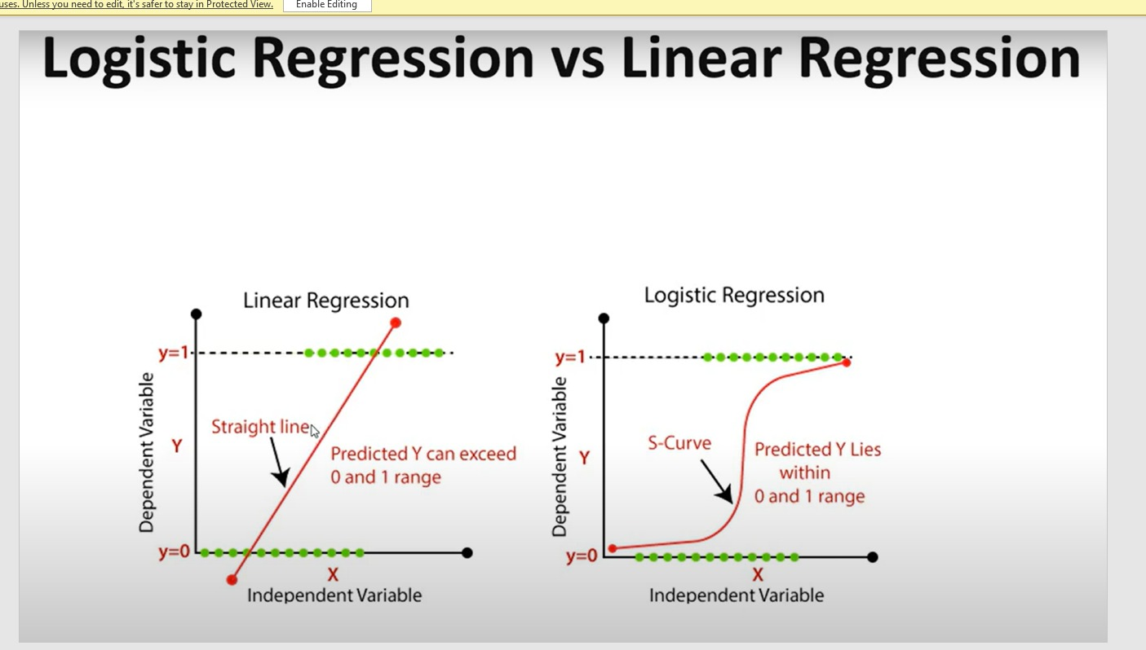
The Logistic Regression Model

Slide 21

Why Do We Need the Sigmoid Function
The Limitation of a Linear Score
A linear function can produce any real-valued output, including negative values and values greater than 1.
Such outputs cannot directly represent probabilities.
Logistic Regression applies the sigmoid function to transform the linear score into a value between 0 and 1.
The resulting value can be interpreted as the model's estimated probability of belonging to the positive class.
The Sigmoid Function
Important Properties
The sigmoid output is always strictly between 0 and 1 for finite z.
When z = 0, the sigmoid output is 0.5.
Large positive values of z produce probabilities close to 1.
Large negative values of z produce probabilities close to 0.

Slide 22
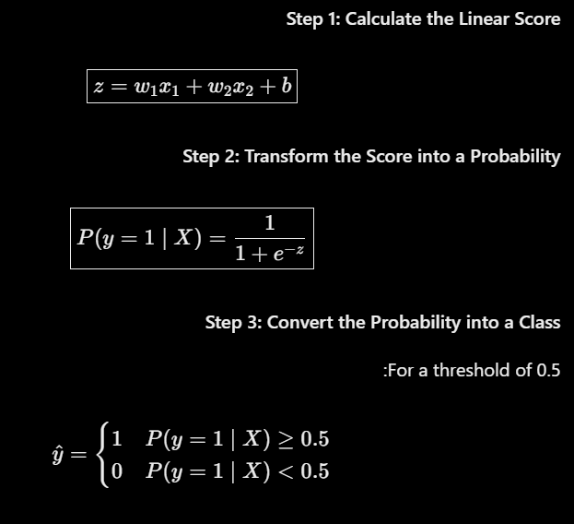
The Logistic Regression Model
Interpretation
The linear function calculates a score from the input features.
The sigmoid function converts the score into an estimated probability.
The decision rule assigns the observation to Class 0 or Class 1.
The threshold can be adjusted depending on the application and the relative costs of different classification errors.

Slide 23
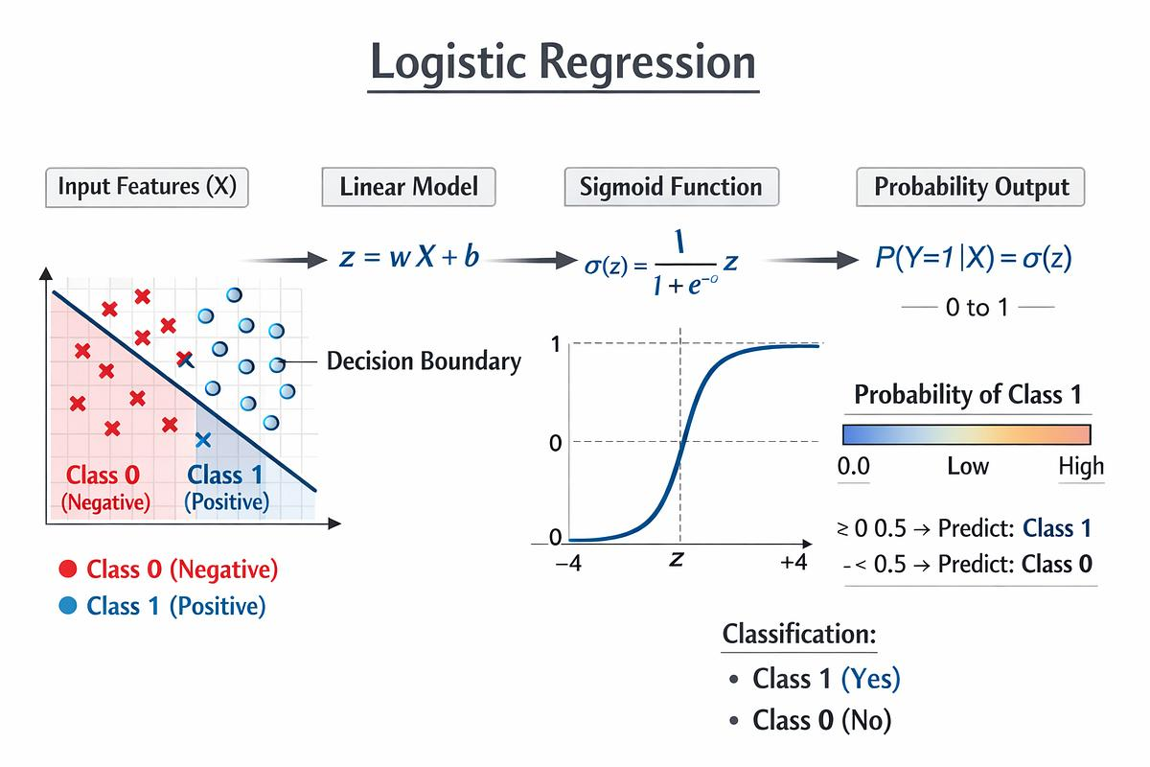
The Logistic Regression Model

Slide 24
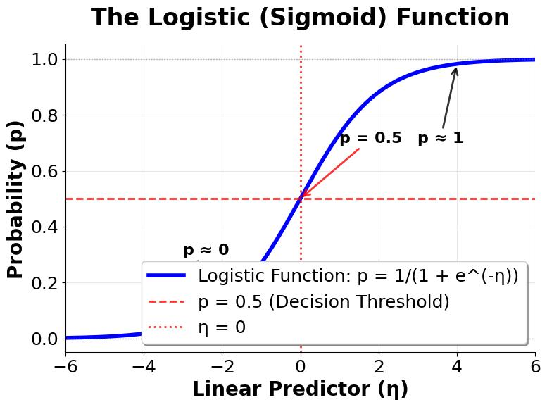
Visualizing the Sigmoid Function
The sigmoid function has an S-shaped curve.
Its output increases as the linear score increases.
The curve approaches 0 for very negative scores and approaches 1 for very positive scores.
At a score of zero, the estimated probability is 0.5.
The sigmoid curve provides a smooth transformation from an unrestricted linear score to a probability.

Slide 25
Classification Threshold
From Probability to a Final Decision
A classification threshold is the probability cutoff used to convert a predicted probability into a class label.
The threshold is commonly set to 0.5 as a starting point for binary classification.
Probabilities at or above the threshold are assigned to Class 1.
Probabilities below the threshold are assigned to Class 0.
The threshold can be adjusted to balance different types of classification errors.
Important: Changing the threshold changes the classification rule, not the probability originally produced by the model.

Slide 26

How Does Logistic Regression Learn
Training Objective
Logistic Regression learns the model weights and bias from labeled training data.
The model compares its predicted probabilities with the true class labels.
Binary Cross-Entropy, also known as Log Loss, is commonly used as the training loss.
The learning algorithm adjusts the parameters to minimize the loss.
Lower loss indicates that the predicted probabilities better match the observed labels according to the loss function.
Binary Cross-Entropy Loss:
When the true label is 1, the loss penalizes low predicted probabilities for Class 1.
When the true label is 0, the loss penalizes high predicted probabilities for Class 1.
Confident and incorrect predictions receive a large penalty.

Slide 27
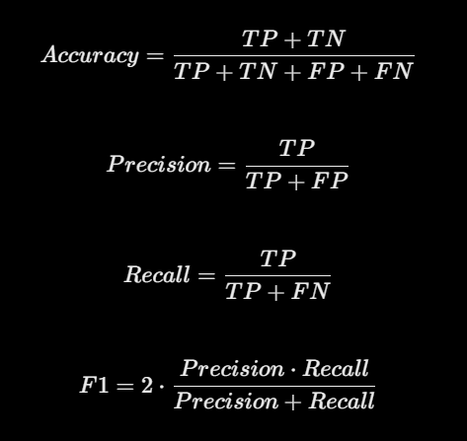
Evaluating Logistic Regression
Accuracy: The proportion of all predictions that are correct.
Precision: The proportion of predicted positive cases that are actually positive.
Recall: The proportion of actual positive cases correctly identified.
F1-Score: The harmonic mean of precision and recall.
Confusion Matrix: Summarizes correct and incorrect predictions for each class.
Confusion Matrix Terms
True Positives — positive cases correctly predicted.
True Negatives — negative cases correctly predicted.
False Positives: negative cases incorrectly predicted as positive
False Negatives: positive cases incorrectly predicted as negative.

Slide 28
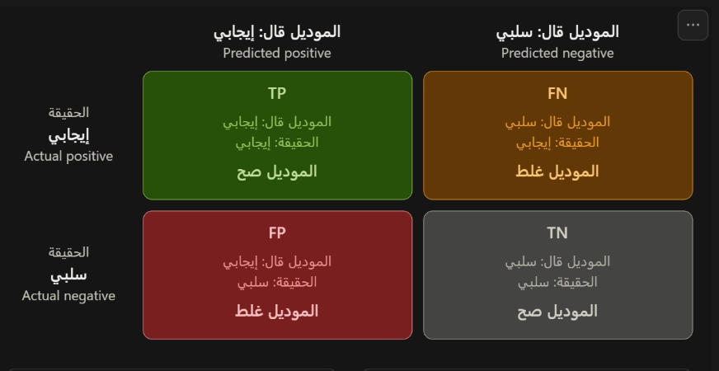
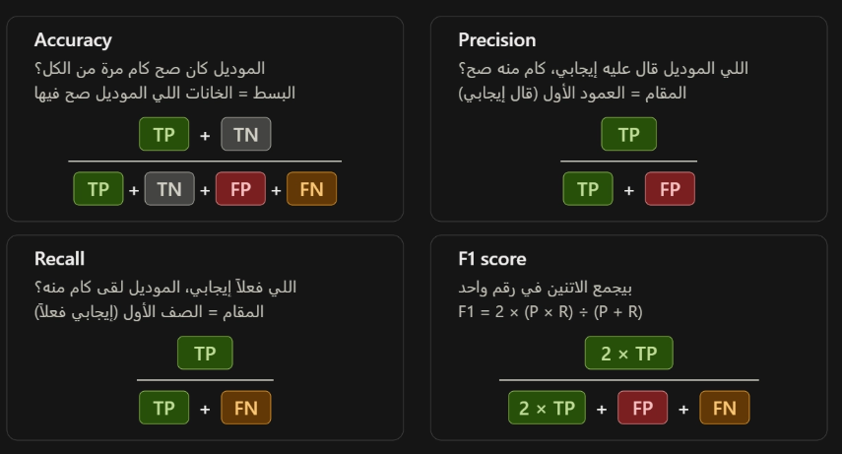
Evaluating Logistic Regression

Slide 29
Advantages and Limitations of Logistic Regression
Advantages
Simple, efficient, and relatively easy to interpret.
Produces estimated probabilities for binary classification.
Supports regularization to help control overfitting.
Provides interpretable coefficients in terms of changes in the log-odds.
Serves as a strong baseline for many classification tasks.
Limitations
Its standard decision boundary is linear in the original feature space.
It may perform poorly when the relationship between features and classes is highly nonlinear.
Its performance can be affected by irrelevant features, multicollinearity, and outliers.
Feature scaling may be beneficial, especially when regularization is used.
Predicted probabilities may require calibration when accurate probability estimates are important.
Typical Applications: Spam detection, customer churn prediction, binary medical screening, and credit default prediction.

Slide 30
Linear Regression vs. Logistic Regression
Comparison | Linear Regression | Logistic Regression
Primary task | Regression | Classification
Target | Continuous numerical value | Categorical class label
Model output | Numerical prediction | Estimated class probability
Core function | Linear equation | Linear score followed by sigmoid
Common training objective | Mean Squared Error / OLS | Binary Cross-Entropy
Example | Predicting exam scores | Predicting Pass or Fail
Evaluation | MAE, MSE, RMSE, R2 | Accuracy, Precision, Recall, F1
The Main Difference
Linear Regression estimates a numerical value, whereas Logistic Regression estimates a probability that can be used to assign a class label.

Slide 31
Important Points to Remember
Linear Regression and Logistic Regression are not interchangeable; they address different prediction objectives.
Logistic Regression is commonly used for classification despite the word “regression” in its name.
A predicted probability of 0.8 does not guarantee that the positive outcome will occur.
A linear classifier does not necessarily refer to Logistic Regression; other algorithms can also produce linear decision boundaries.
The classification threshold is a decision setting and does not change the probability produced by a fixed model.
High training performance does not guarantee good performance on unseen data.
Models should be evaluated on data that was not used for training.

Slide 32
Summary
Linear Regression predicts continuous numerical values by learning a relationship between input features and a numerical target.
Binary Linear Classification separates observations into two classes using a classification decision rule.
Logistic Regression transforms a linear score into a probability using the sigmoid function.
The Decision Boundary separates regions assigned to different classes.
The Loss Function measures model errors during training and guides parameter estimation.
Evaluation Metrics help determine whether a model performs well on unseen data.
Final Rule
Predicting a number → Regression.
Predicting a category → Classification.
Predicting the probability of one of two classes → Logistic Regression is a common choice.

Slide 33
1. We want to predict the exact price of a house. Which model is the natural starting point?
Linear Regression
Logistic Regression
K-Means
2. A model estimates a 0.85 probability that an email is spam. Which model naturally produces this probability for binary classification?
Linear Regression
Logistic Regression
K-Means.
3. What does the decision boundary do in binary classification?
Calculates the mean of every feature
Separates regions assigned to different classes
Always predicts a probability of 0.5

Slide 34
THANK
YOU

